Slide 1

GAME MANAGEMENT
AND
CREW COMMUNICATION
Your Survival and Your Success
Depends On Both

Slide 2
ESSENTIALS TO HELP YOU BE SUCCESSFUL ON THE FLOOR
Rule knowledge and understanding
Be a student of the game
Be up-to-date on your officiating knowledge
Have a never-ending respect for the game
Understand your role in the contest is no more important than anyone else’s
Understand that game management and crew communication go hand in hand
COMMUNICATION!

Slide 3
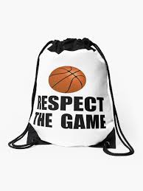
RESPECT THE GAME…
RESPECT THE COACH…
Quality officials…
  …respect the game and all that coaches and players do.
  …understand the pressure of the game.
  …truly understand that every coach wants to win. In many cases, the coach’s livelihood is connected to winning.
  …know the importance of “Getting it right.”

Slide 4
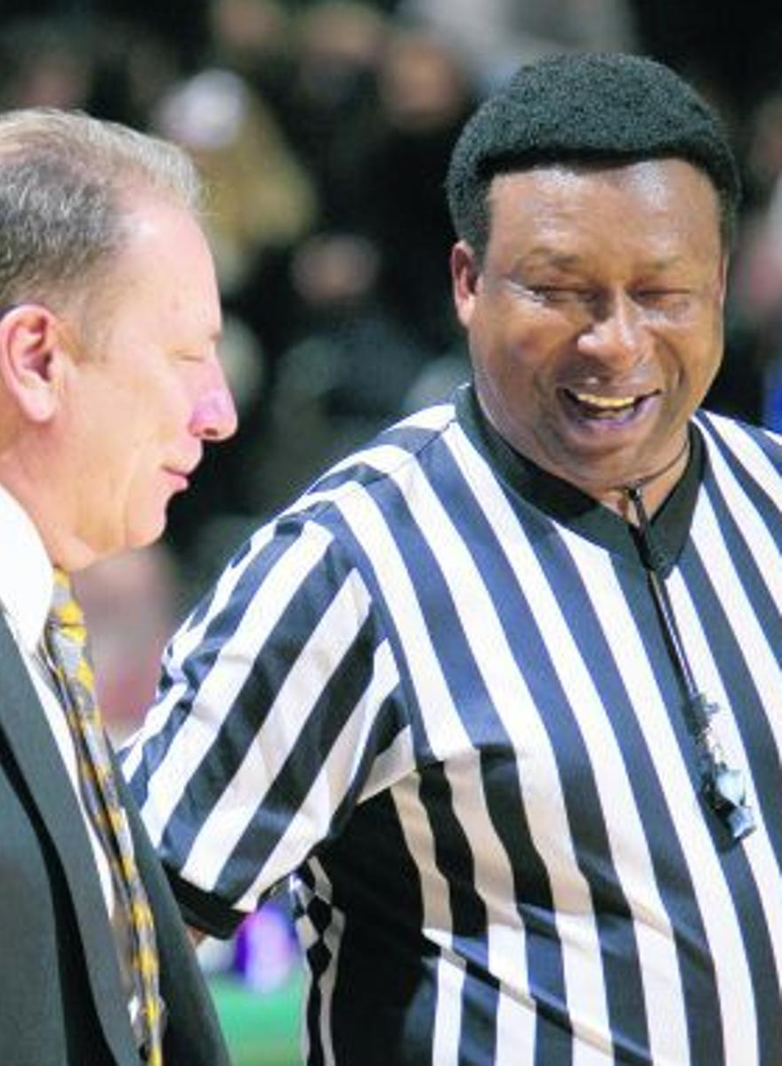
COMMUNICATION
Coaches want, and deserve, to be heard, and quality officials know this, so listen and communicate without interfering with the coach’s duties.
Coaches will get upset at times. The best coaches AND officials deal with it in the moment and then MOVE ON.
Humor at the right time goes a long way.

Slide 5
IMPORTANCE OF COMMUNICATION
Communication is essential to quality officiating.
Both verbal and non-verbal communication are critical to our success as officials.
Officials should always be looking for ways to improve our communication skills.
“Coach, you might be right.”

Slide 6
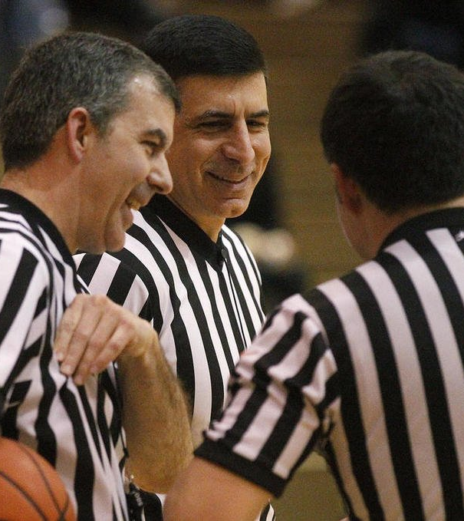
COMMUNICATING BEFORE THE CONTEST
COMMUNICATE WITH YOUR PARTNER(S)…
  Confirm the assignment.
  Ride together?
  Discuss any issues pertaining to this specific contest.
ON SITE AND PREGAME COMMUNICATION WITH…
  Athletic Director or Designee…
  Check-in
  Locker facilities
  Payment (when appropriate)
  Anything else we need to know?

Slide 7
COMMUNICATING BEFORE THE CONTEST
ON SITE AND PREGAME COMMUNICATION WITH…
  Athletic Director or Designee…
  Check-in
  Locker facilities
  Payment (when appropriate)
  Anything else we need to know?

Slide 8
BEFORE THE CONTEST
ON SITE AND PREGAME COMMUNICATION WITH…
  Scorer(s)/Scorers Table/Timer/Press Box…
    Discuss information pertinent to that contest.
    Assure them ‘You’re all in this together.’
LIVE BALL/DEAD BALL COMMUNICATION WITH…
  Scorers Table…
    ALWAYS use approved signals/mechanics.
    Take your time presenting the appropriate information so problems are prevented.

Slide 9
DURING THE CONTEST
LIVE BALL/DEAD BALL COMMUNICATION WITH…
  Scorers Table…
    ALWAYS use approved signals/mechanics.
    Take your time presenting the appropriate information so problems are prevented.

Slide 10
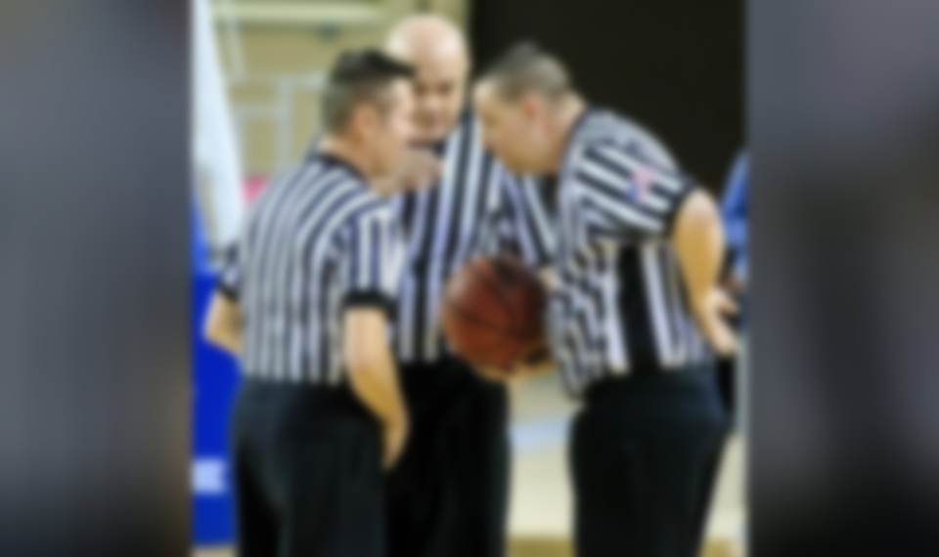
DURING THE CONTEST
LIVE BALL/DEAD BALL COMMUNICATION WITH…
  Your Partner(s)…
    Communicate essential information.
      Player or Coach Situations
      Eye Contact/Hand Signals on Throw-Ins
      Bonus Situations
      Last Second Shot
    Use appropriate non-verbal signals to aid communication with your partner(s).
    Use intermissions and timeouts to your advantage.

Slide 11
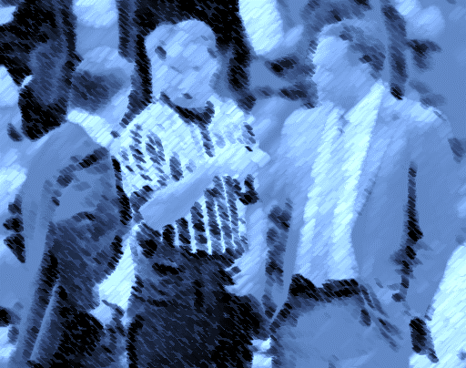
DURING THE CONTEST
LIVE BALL/DEAD BALL COMMUNICATION WITH…
  Coaches…
    Communicating with players and coaches is the essence of preventive officiating.
    Be cordial but detached.
    Follow through on what you tell the coaches.
  Players…
    Communicating with players and coaches is the essence of preventive officiating.
    Do your best to show the players you are competent and approachable.

Slide 12
DURING THE CONTEST
LIVE BALL/DEAD BALL COMMUNICATION WITH…
  Players…
    Communicating with players and coaches is the essence of preventive officiating.
    Do your best to show the players you are competent and approachable.

Slide 13
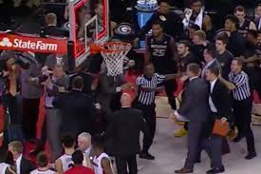
DURING THE CONTEST
LIVE BALL/DEAD BALL COMMUNICATION WITH…
  Game Management…
    Know how to find Game Management should a situation occur which requires assistance.
    Do all you can to have Game Management deal with crowd control incidents which directly involve abuse to players, coaches and officials.
    NEVER touch a player. Get the proper people involved in these situations.

Slide 14
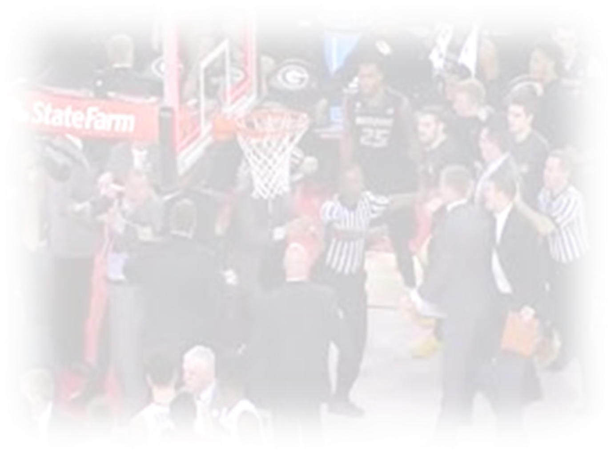
AFTER THE CONTEST
POSTGAME REVIEW WITH YOUR PARTNER(S)…
  Discuss any difficult or controversial situations.
  Seek input from other officials who may have been at the contest.
  Assess your performance. (Game tape?)
POSSIBLE REASONS TO COMMUNICATE WITH ASSIGNMENT CONTACTS…
  Incident(s) that occurred in the contest which you need to pass on to the Assignment Contact.
  Filing of appropriate reports with the IHSA. (Special Report Form, SAWA Report.)

Slide 15
AFTER THE CONTEST
POSSIBLE REASONS TO COMMUNICATE WITH ASSIGNMENT CONTACTS…
  Incident(s) that occurred in the contest which you need to pass on to the Assignment Contact.
  Filing of appropriate reports with the IHSA. (Special Report Form, SAWA Report.)

Slide 16
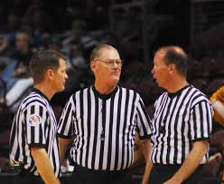
GAME MANAGEMENT AND CREW COMMUNICATION GO HAND IN HAND
Solid pregame in our locker room.
Clear understanding of IHSA expectations on bench decorum, sportsmanship and illegal contact.
Agreement on how game will be officiated.
Be proactive and be approachable in all communication with all involved in the game.
Address the coaches box CONSISTENTLY!
Be prepared to involve game/host management if any issue arises which warrants their assistance. (i.e. irate fan, uncooperative coach)

Slide 17
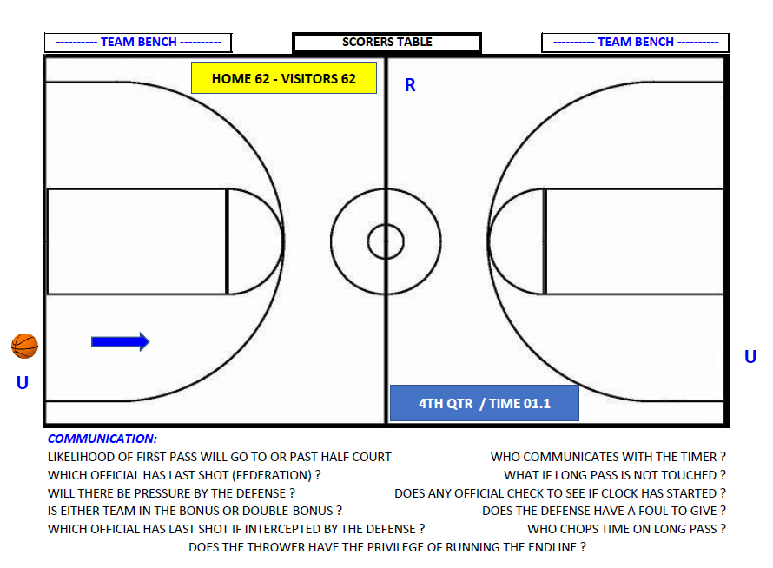
Communication – Last Second Shot

Slide 18
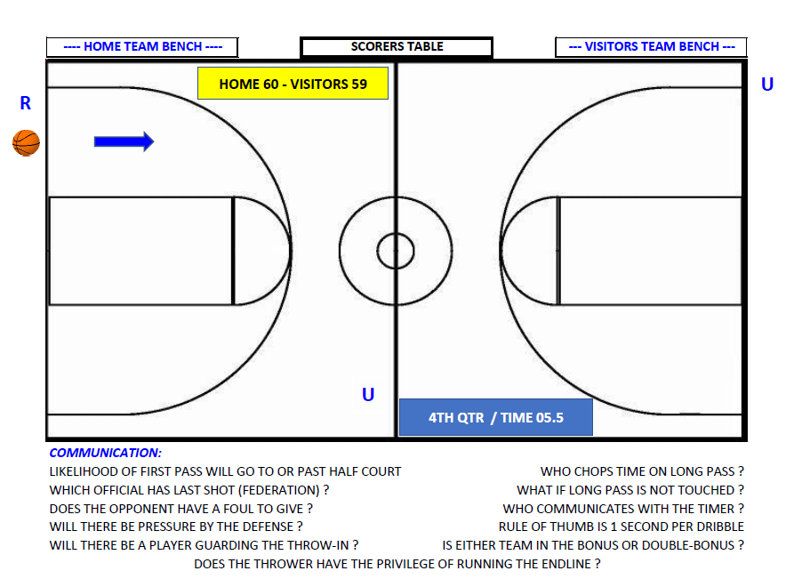
Communication – Last Second Shot

Slide 19
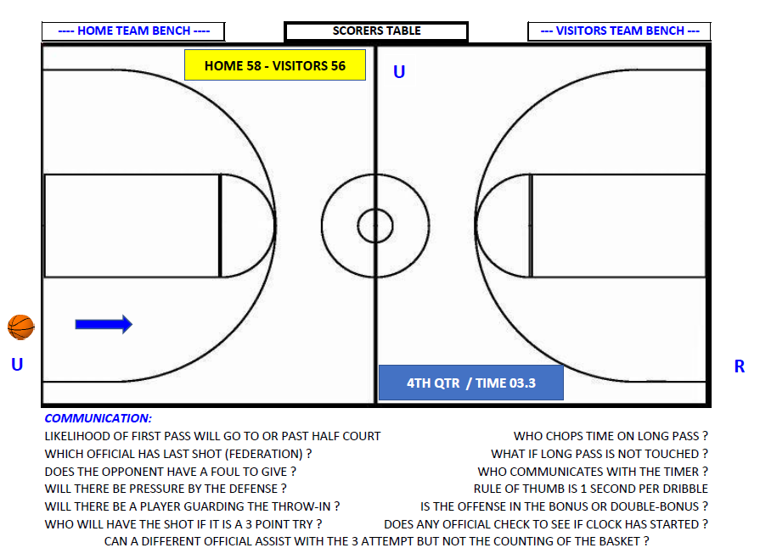
Communication – Last Second Shot

Slide 20
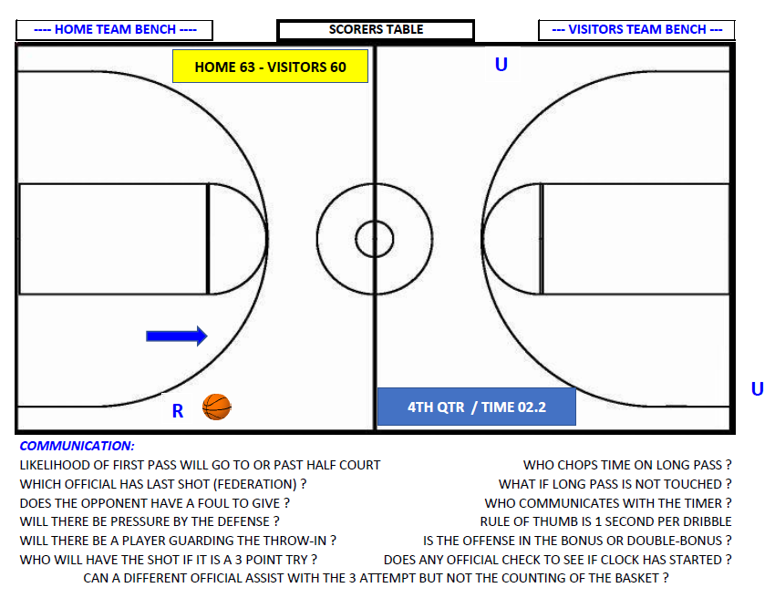
Communication – Last Second Shot

Slide 21
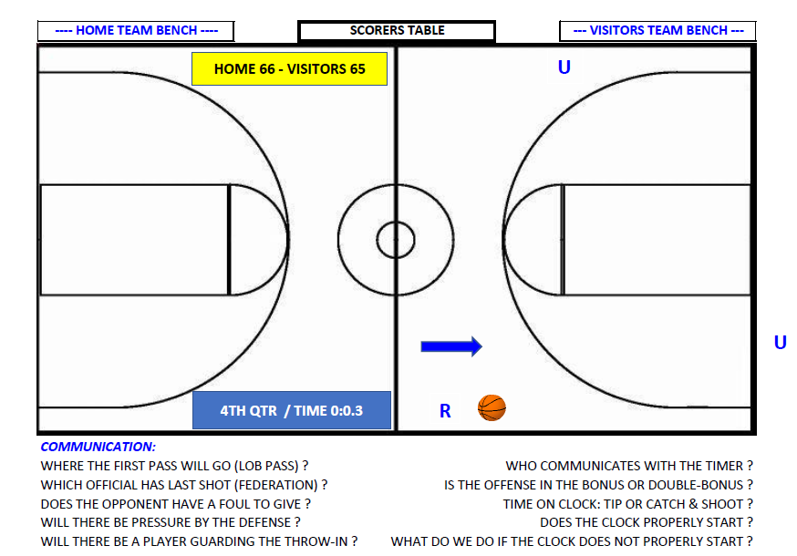
Communication – Last Second Shot

Slide 22



BE PREPARED FOR A GREAT SEASON!
THANKS FOR YOUR ATTENTION!

